Slide 1
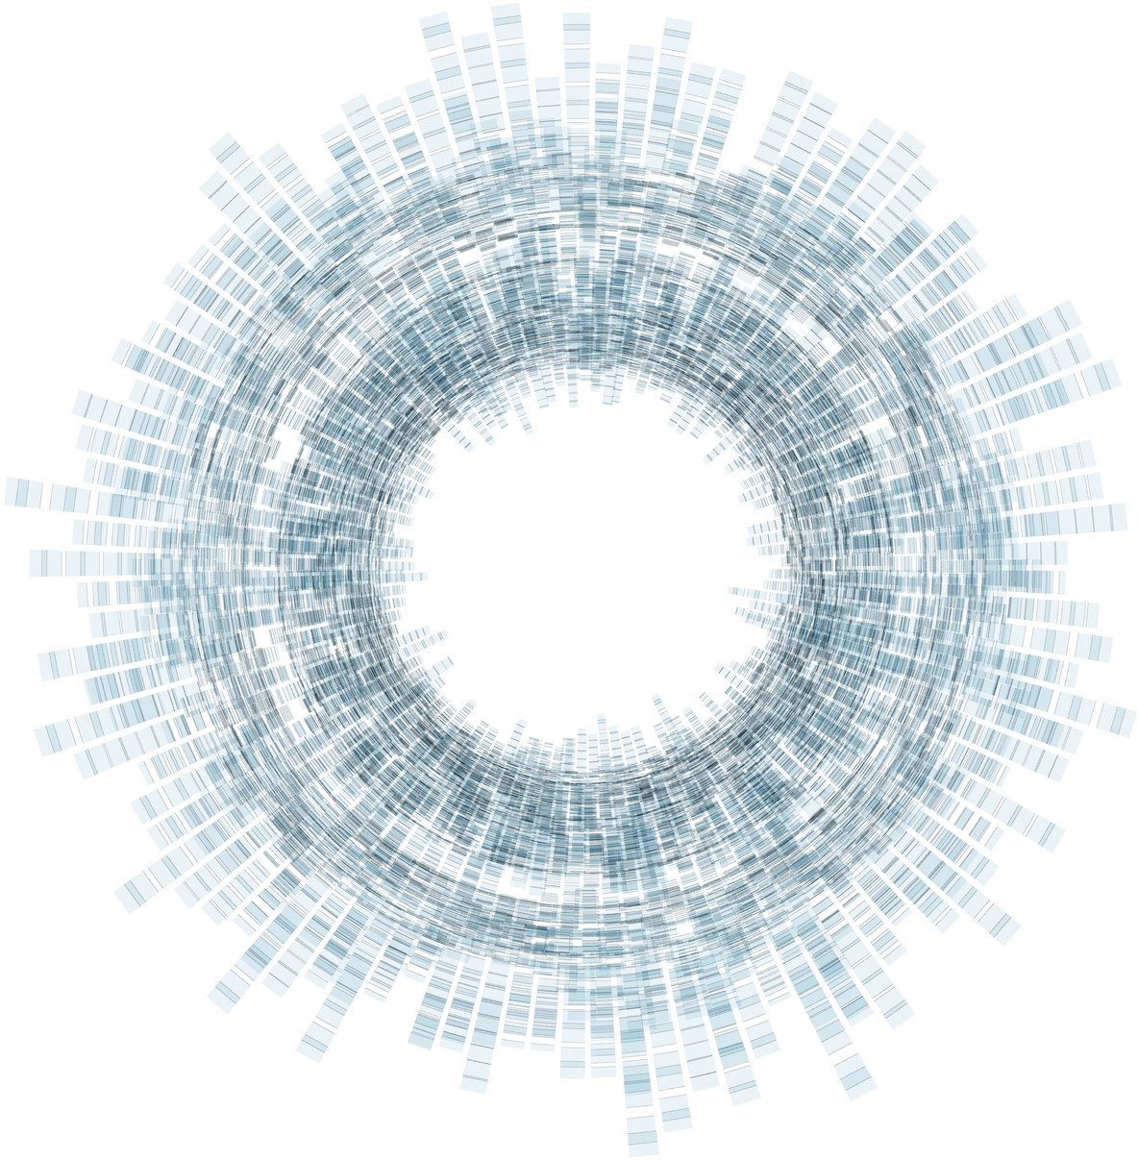

Artificiële Intelligentie
RCA AIG 04Q6 08 APRIL 2021
Computational Foundations of
Machine Learning [ML]
with Python
DataLab
Rob van der Willigen

Slide 2


CONTEXT
Prerequisites: basics in linear algebra, probability, and analysis of algorithms.
Workload: homework assignments
GitHub: Start a ML repository at GitHub

Slide 3
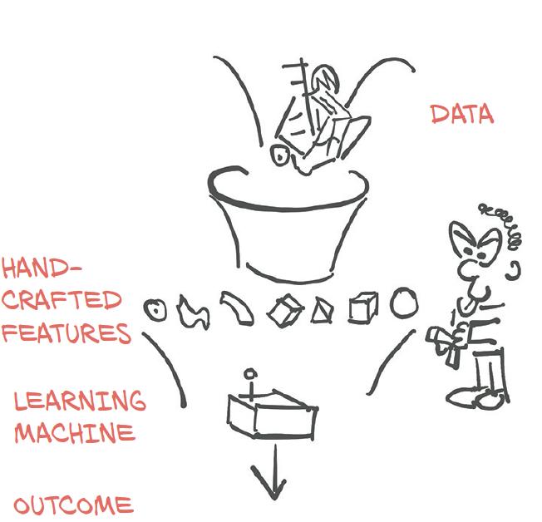
MACHINE LEARNING [ML]

Slide 4
Lecture 04
Basic deﬁnitions and concepts of Machine Learning (ML) PART02. How to get from ML concepts & Models to Python code.
BACKPROPAGATION
Neural Network
Perceptron Class
Initialise
Train
Query
set size, initial weights
do the learning
query for answers

Slide 5
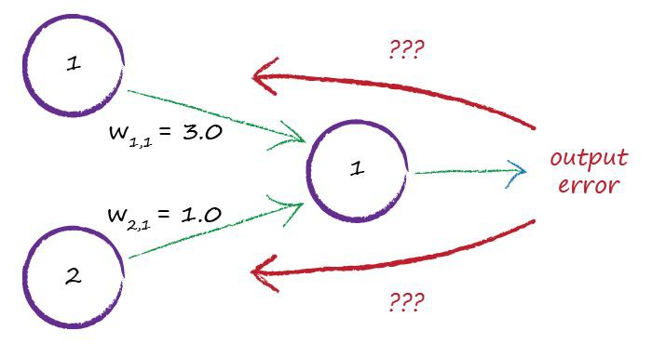
Network Error
Lecture 04
How do you get a Perceptron to learn?
It needs to perform iterative FEED BACKWARD calculation!

Slide 6
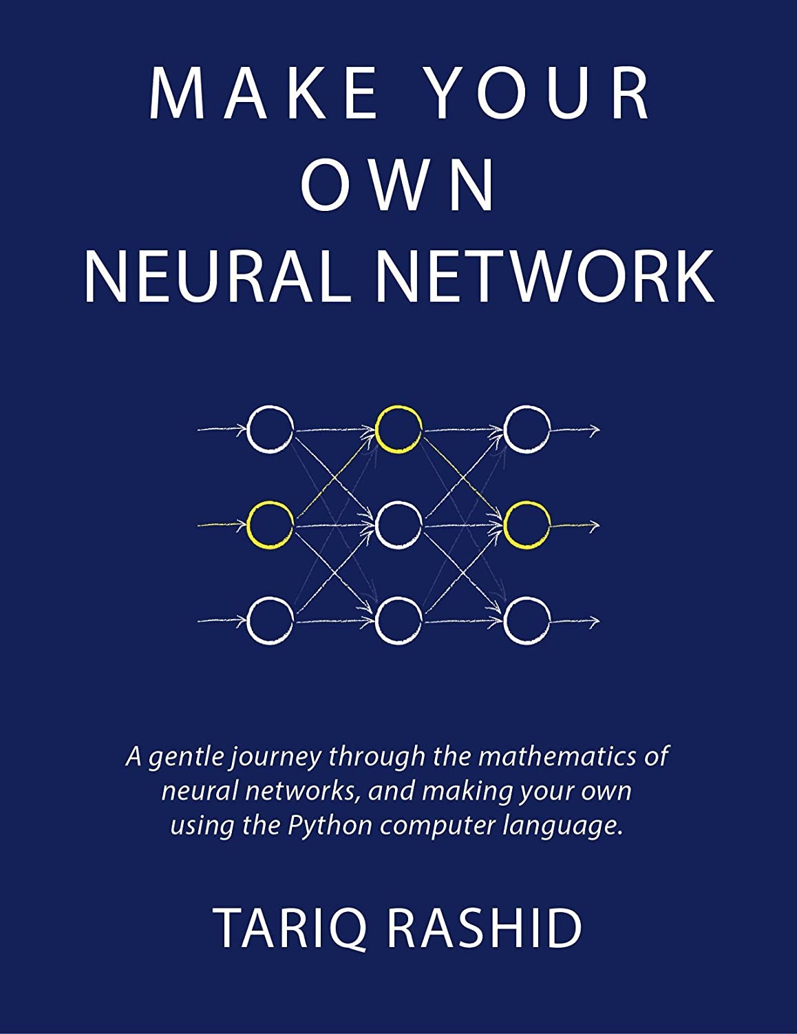
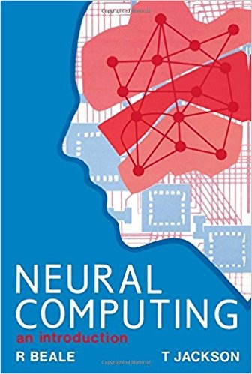
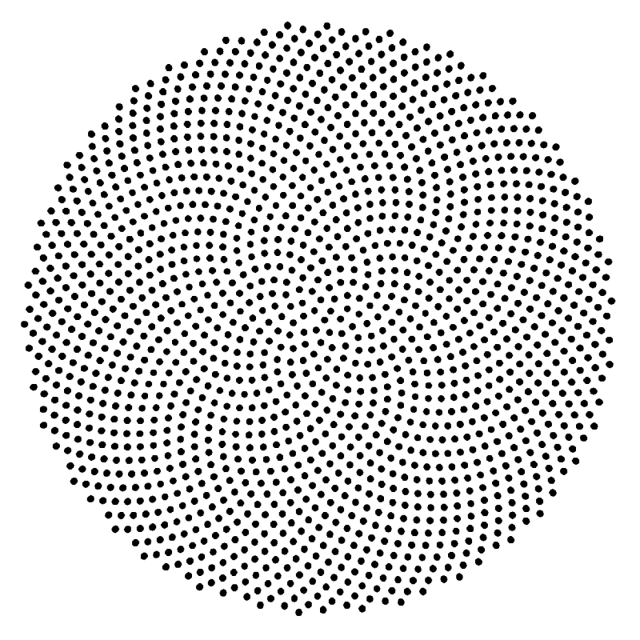
{01}
Fundamentals

Slide 7
{01}
Fundamentals
Key-words / Concepts / Labels
Artificial neuron === Model of single biological neuron / Perceptron
Feedforward / Feed-backward / Hebbian learning
Bias / Threshold
Weights /adjustable parameters / Memory
Unit / Node / Activation Functions (Sigmoid / Step)
Input / Output / Layers / Input vs Output Space
Target / Teacher / Error / learning rate
Iterations / Epochs / Baches
Logical functions AND / OR / XOR (Boolean Algebra)

Slide 8
{01}
Fundamentals
Maths + Python Key-words / Concepts
PYTHON MODULES import Numpy as np
import Matlibplot.pyplot as plt
class
def return
for (loops)
if else
zip
print
list
append
+=
Matrix Calculus
np.zeros
np.random.normal
np.dot
Plotting
plt.subplots()
plt.subplot(221)
plt.plot(epoch, error)
plt.xlabel('Epoch')
plt.ylabel('Error')

Slide 9
{01}
Fundamentals
Perceptron
The perceptron was very promising, but it was soon discovered that is has serious limitations as it only works for linearly-separable classes.
In 1969, Marvin Minsky and Seymour Papert
demonstrated that it could not learn even a simple logical function such as XOR.
This led to a significant decline in the interest in perceptron’s
and Machine learning as a whole.

Slide 10
{01}
Fundamentals
Perceptron
A Perceptron is a binary classifier that was invented by Frank Rosenblatt in 1958, working on a research project for Cornell Aeronautical Laboratory that was US government funded.
It was based on the advances with respect to mimicing the human brain, in particular the MCP architecture that was recently invented by McCulloch and Pitts.
This architecture attempted to mimic the way neurons operate in the brain: given certain inputs, they fire, and their firing behaviour can change over time.
By allowing the same to happen in an artificial neuron, researchers at the time argued, machines could become capable of approximating human intelligence.

Slide 11
MACHINE LEARNING [ML]

Slide 12
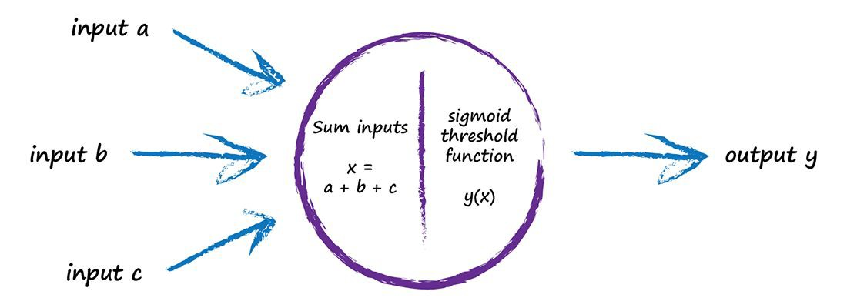
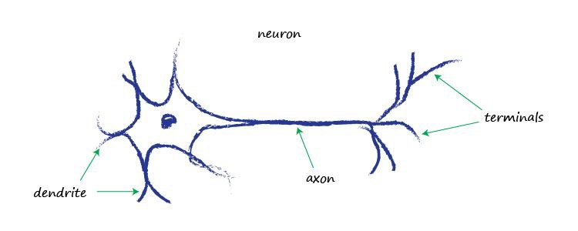
{01}
Fundamentals
Artificial Neuron
Artificial Neuron Model:
Perceptron input vs output

Slide 13
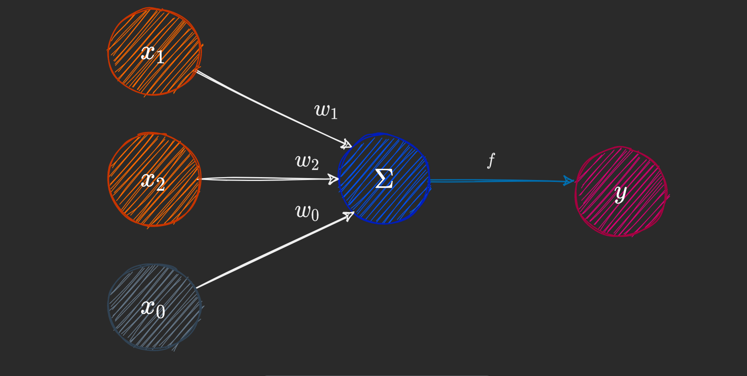
{01}
Fundamentals
Artificial Neuron
PERCEPTRON
Architectural components
Perceptron Components :
Input nodes x₀ … x_{n}
Output node y
Weights w₀ … w_{n}
bias (=weight zero) w₀
Summation Σ (sigma)
Activation Function f

Slide 14
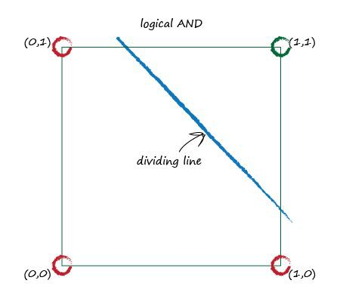
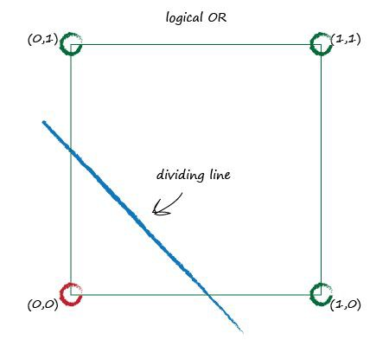
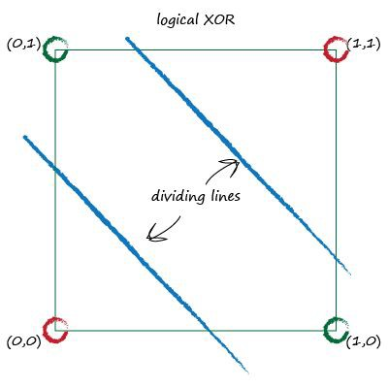
XOR Puzzle!

Slide 15
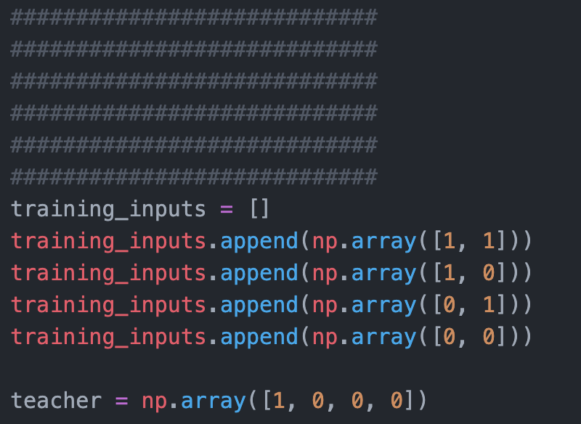
{01}
Fundamentals
PERCEPTRON
Input /output relationship [logical AND]
Pseudo code:
Define number of training inputs. (n=2)
Create binary input value matrix
for x vector [x₁ x₂]
0 0
0 1
1 0
1 1
Define epoch (or batch) length (n=4)
Equals max number of binary input combinations of 2
Define teacher as a vector for the desired target values (n=4) to each input combination
[ 0 0 0 1]
Python code

Slide 16
{01}
Fundamentals
XOR Puzzle!
PERCEPTRON
Input /output relationship [logical AND]
Pseudo code:
Define number of training inputs. (n=2)
Create binary input value matrix (training dataset)
for x vector [x₁ x₂]
0 0
0 1
1 0
1 1
Define epoch (or batch) length (n=4)
Equals max number of binary input combinations of 2
Define teacher as a vector for the desired target values (n=4) to each input combination
[ 0 0 0 1]
Epoch:
The number of epochs is a [hyper]parameter that defines the number times [iterations] that the perceptron will have to calculate output for the each of the input pairs of the training dataset
One Epoch
Defined by the ENTIRE input (training) dataset is passed forward only ONCE
=======> Logical AND perceptron
1 Epoch requires n=4 iterations

Slide 17
{01}
Fundamentals
XOR Puzzle!
Perceptron
binary input vs output
Target [TEACHER]
Input x1 | Input x2 | AND y
0 | 0 | 0
0 | 1 | 0
1 | 0 | 0
1 | 1 | 1

Slide 18

Boolean Logic
IF I have eaten my vegetables AND I am still hungry
THEN I can have ice cream.
IF it’s the weekend OR I am on annual leave THEN I’ll go to the park.
Input A | Input B | AND | OR
0 | 0 | 0 | 0
0 | 1 | 0 | 1
1 | 0 | 0 | 1
1 | 1 | 1 | 1

Slide 19
MACHINE LEARNING [ML]

Slide 20
{01}
Fundamentals
PERCEPTRON
Feed Forward Algorithm
Pseudo code:
Initialize the weights vector 𝑤 to zeroes or random numbers
Compute DOT PRODUCT
of the binary input x vector [x₁ x₂]
and binary weight w vector [w₁ w₂]
Where bias b equals w_{0 (weight zero)}
Apply the activation function F

Slide 21
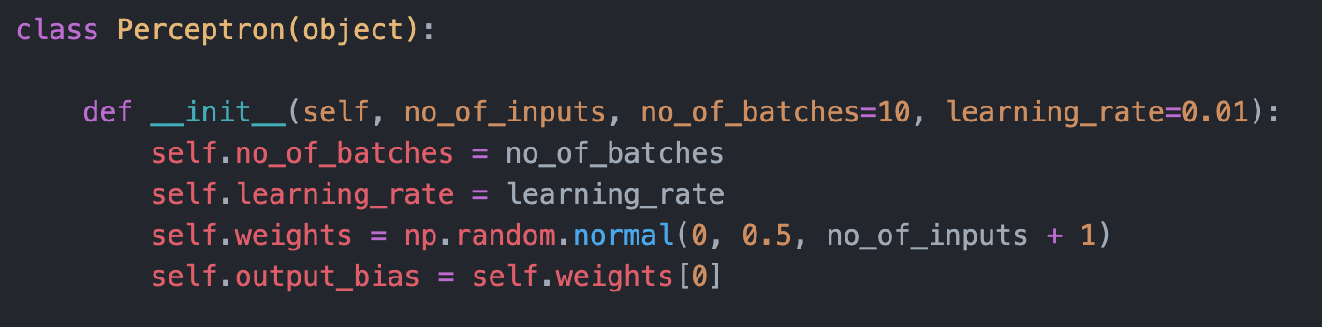
{01}
Fundamentals
Artificial Neuron
PERCEPTRON
Class Python code
pseudo code:
Define initializing object
for the class named Perceptron
Parameter settings
number of inputs x
number of epochs (or batches)
Learning rate
Initialization
Weights-vector (inclusive bias) to zero’s or random numbers

Slide 22
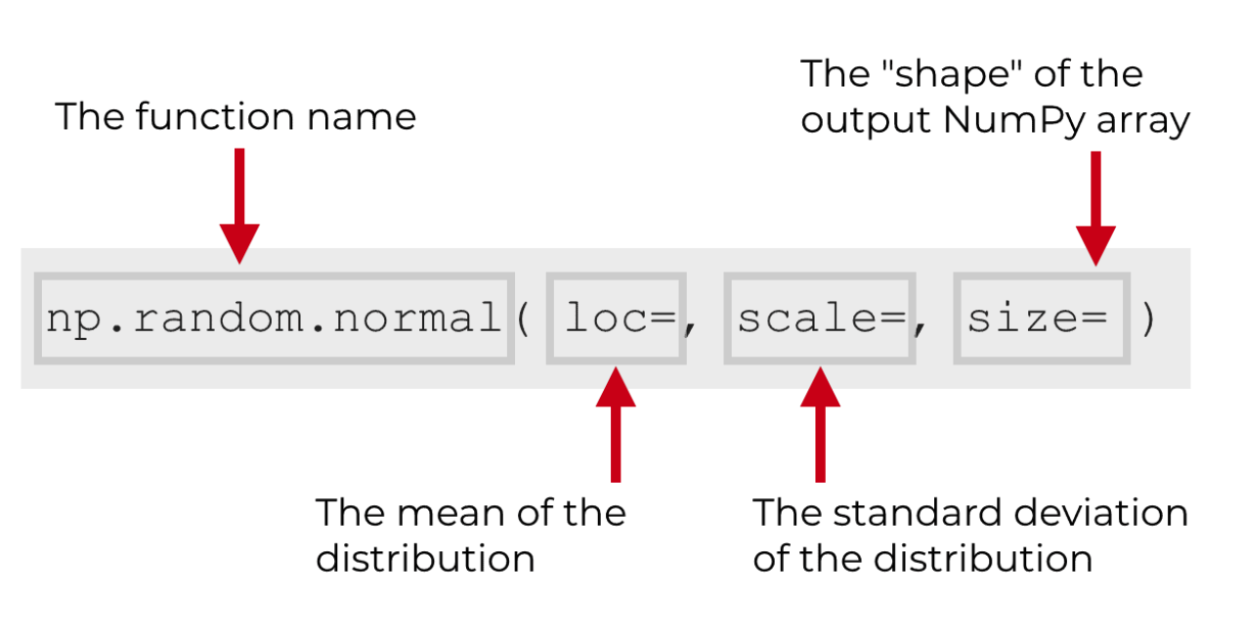
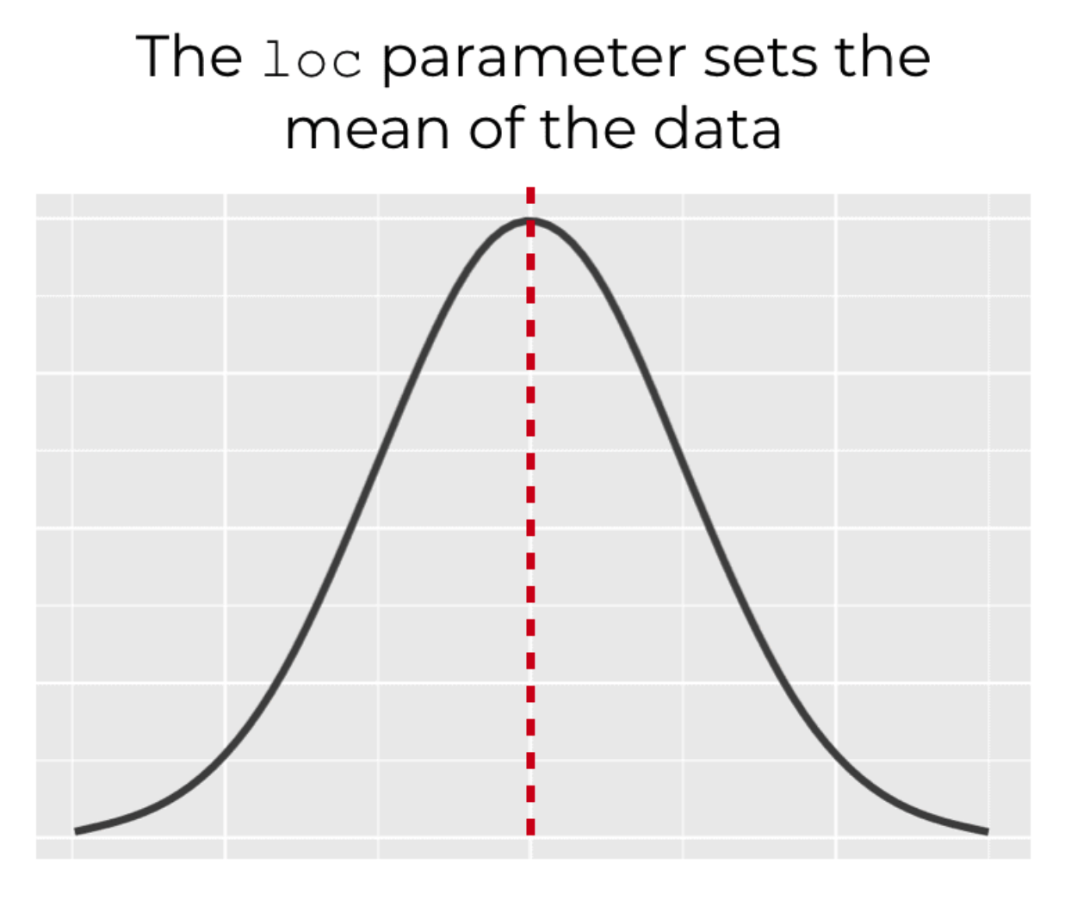
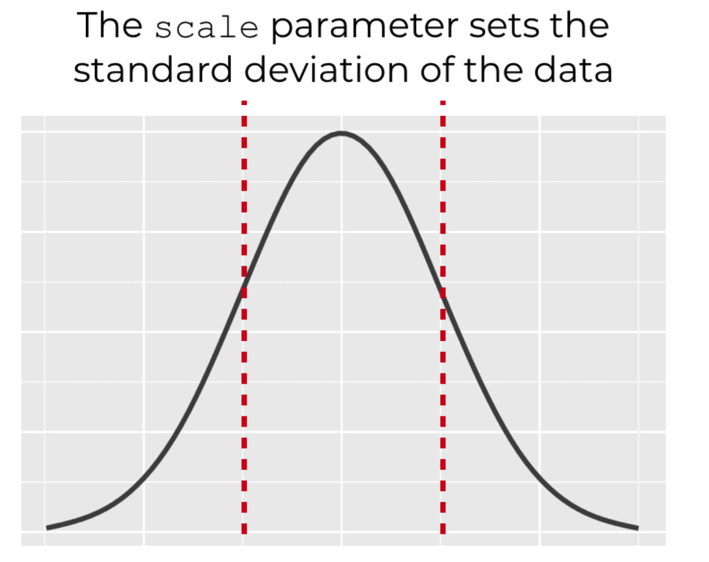
{01}
Fundamentals
Randomization
Normal distribution
Python code

Slide 23
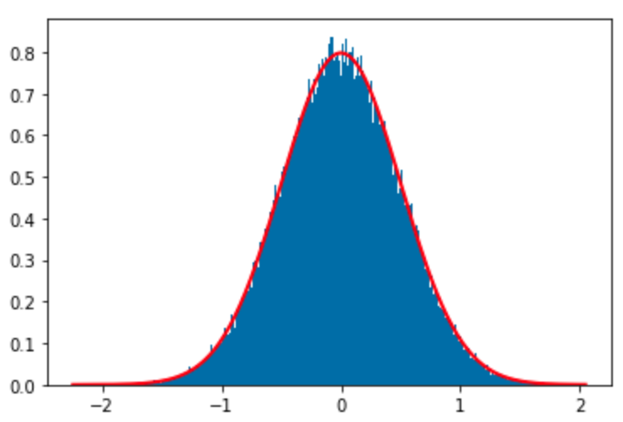
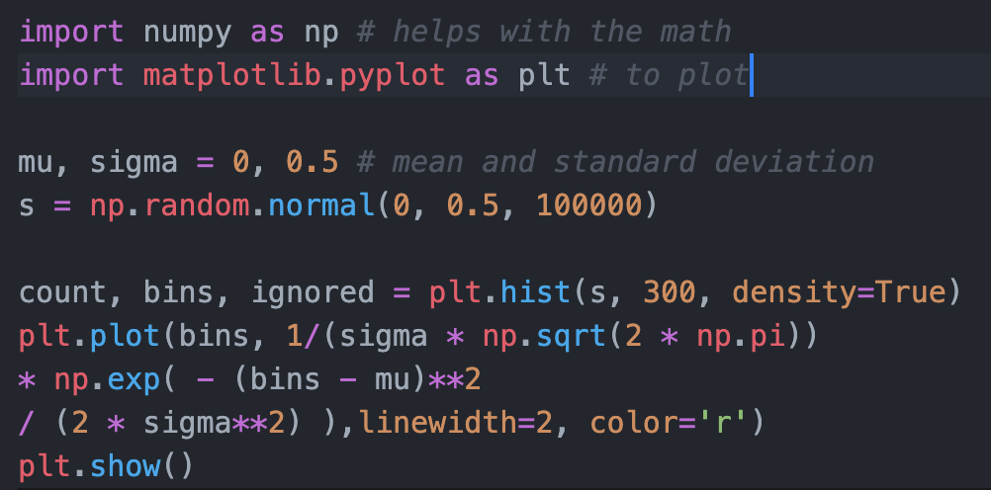
{01}
Fundamentals

Slide 24

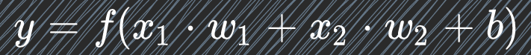
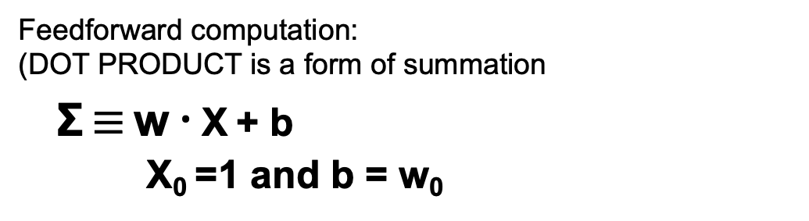
{01}
Fundamentals
Artificial Neuron
PERCEPTRON
Feed Forward maths
Feed Forward
output calculation
pseudo code:
Compute DOT PRODUCT
of the binary input x vector
[x₁ x₂]
and binary weight w vector
[w₁ w₂]
Where bias b equals w_{0 (weight zero)}
Apply the activation function f(x)
Feedforward computation:
(DOT PRODUCT is a form of summation
Σ $≡$ w $⋅$ X + b
X₀ =1 and b = w₀

Slide 25
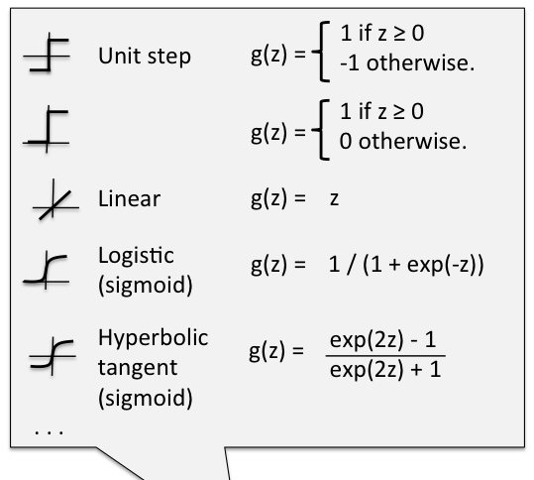
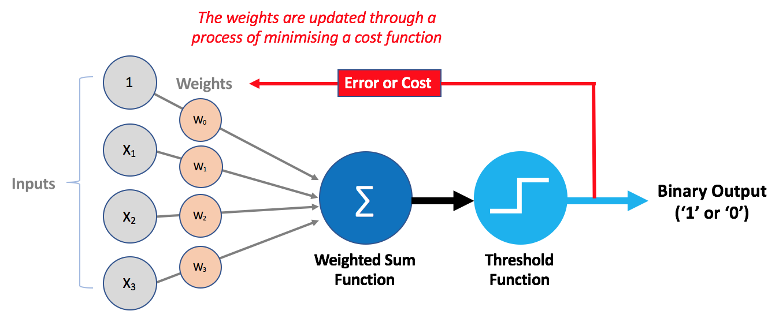
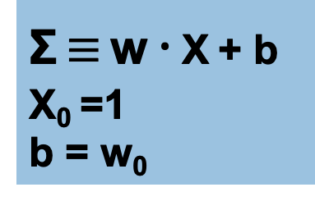
{01}
Fundamentals
PERCEPTRON
Activation output
Net
input (z)
input
output
Σ $≡$ w $⋅$ X + b
X₀ =1
b = w₀
g (z)
Activation

Slide 26
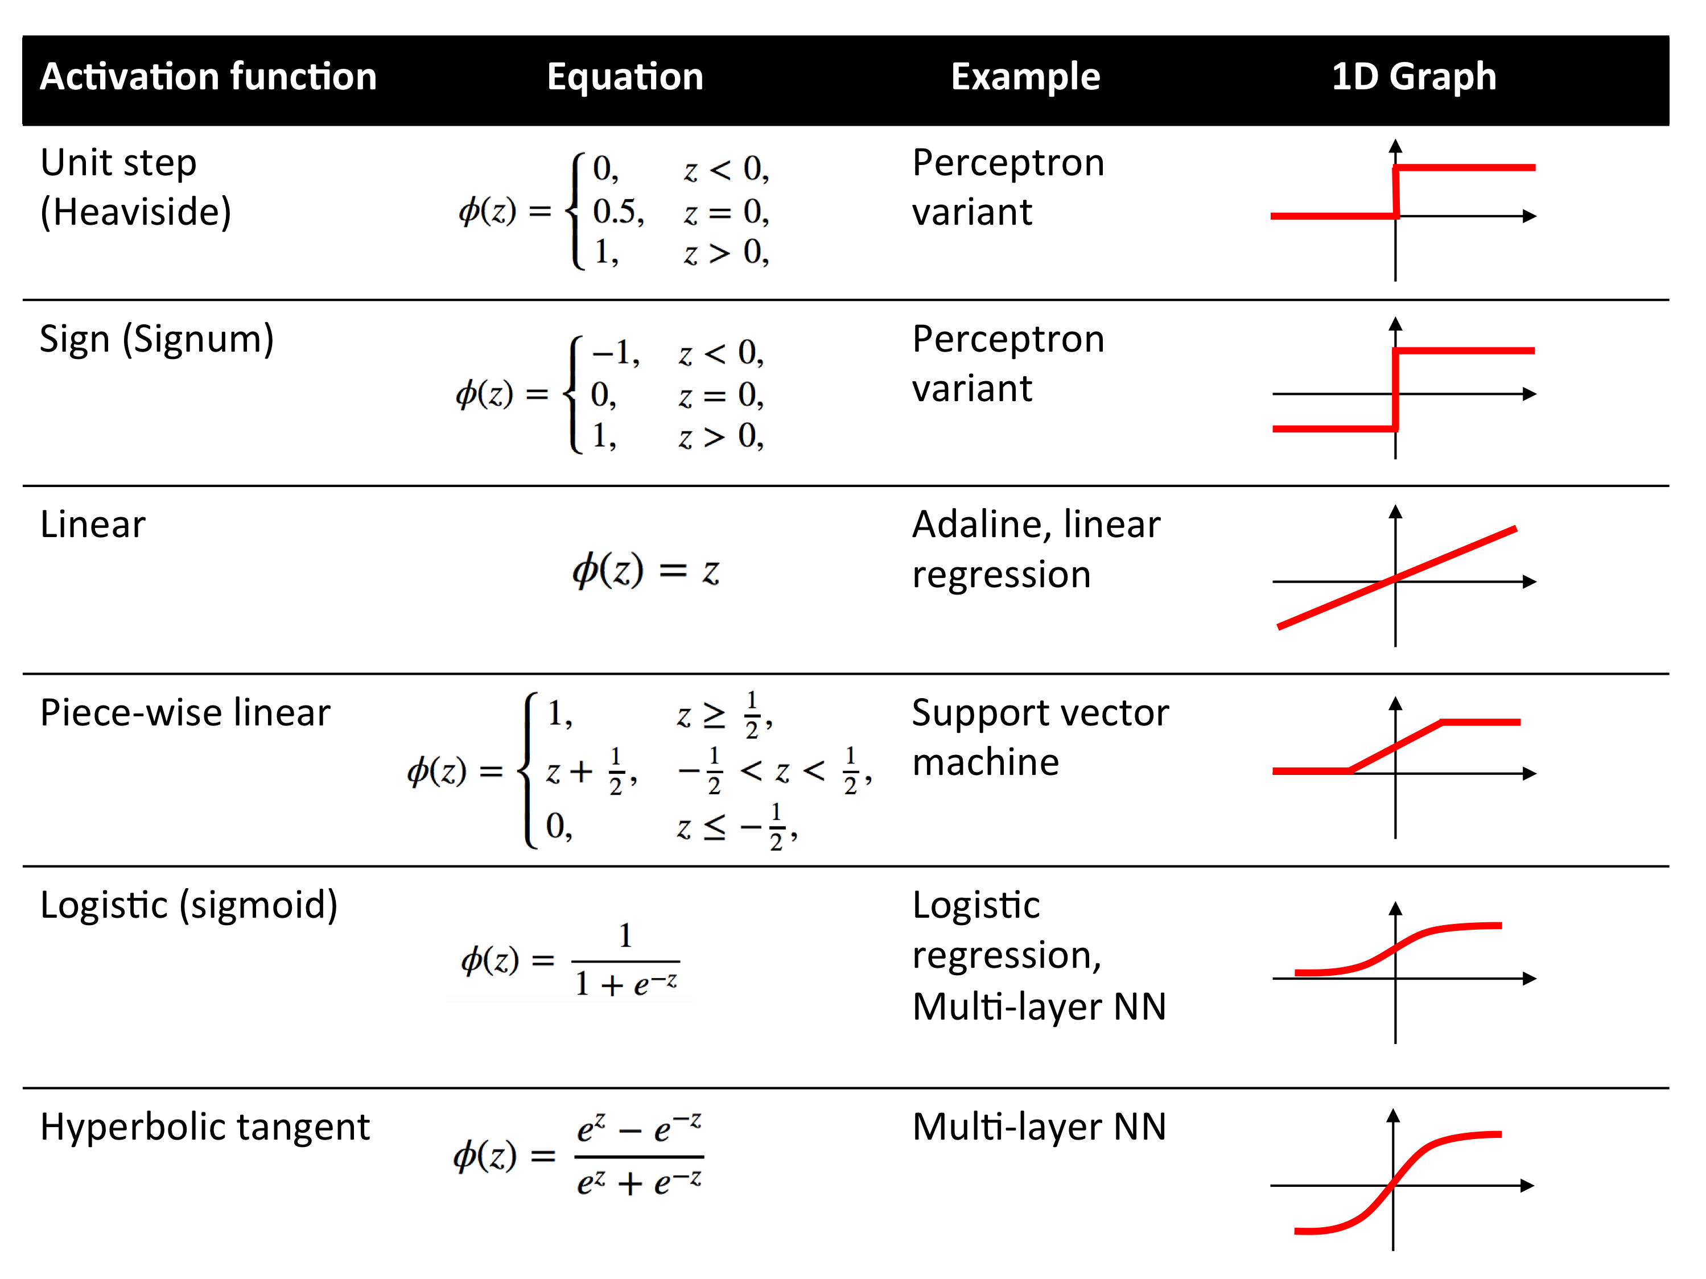
{01}
Fundamentals
XOR Puzzle!
Machine Learning
Activation functions math

Slide 27
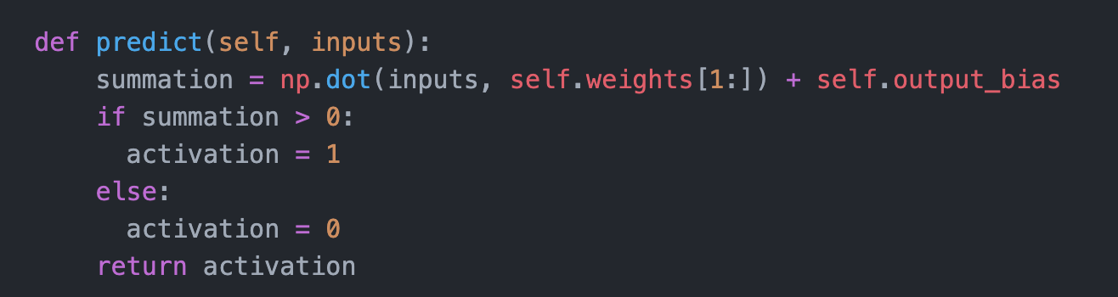
{01}
Fundamentals
Artificial Neuron
pseudo code:
Define a predicted output through a STEP activation function
for the class named Perceptron
During FEED FORWARD Calculation
Apply Activation function with dot multiplication from inputs and the weights
as net input
If net input + bias is greater than 0 then activation is 1
otherwise make output 0
PERCEPTRON
Class Python code

Slide 28
{01}
Fundamentals
Network Error
How do you get a Perceptron to learn?
needs iterative
FEED BACKWARD calculation == Training

Slide 29
{01}
Fundamentals
XOR Puzzle!
Learning occurs through
systematic adaptation of the weights
➔ FEED BACKWARD calculation⬅

Slide 30
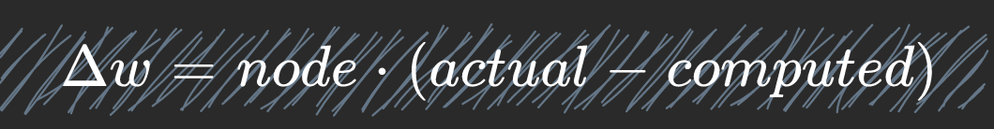
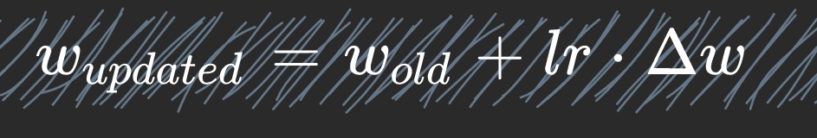
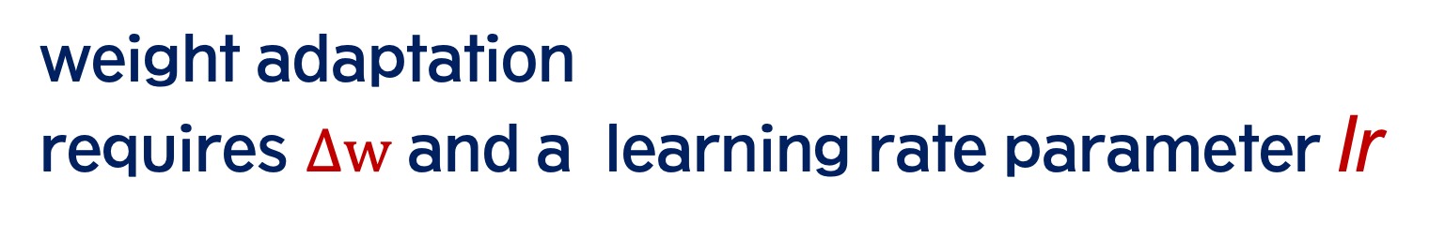
{01}
Fundamentals
XOR Puzzle!
PERCEPTRON
Learning algorithm maths
calculates weight adaptation
Error (Loss or Cost) calculation
weight adaptation
requires $Δw$ and a learning rate parameter lr

Slide 31
{01}
Fundamentals
PERCEPTRON
Learning algorithm maths

Slide 32
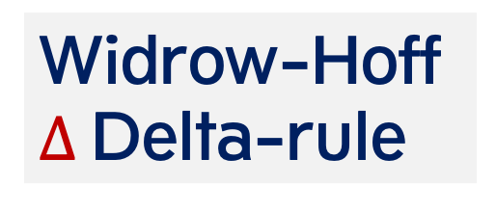
{01}
Fundamentals
PERCEPTRON
Learning algorithm maths
Widrow-Hoff
$Δ$Delta-rule
Neural Networks using the Widrow-Hoff delta rule are called (M)ADALINE: (many) Adaptive Linear Neurons

Slide 33
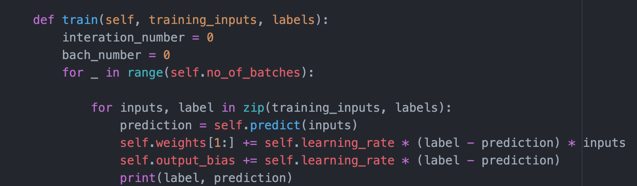
pseudo code:
Define training function
for the class named Perceptron
Define iteration cycle and keep track of the number of iteration
Do this for all possible input/ouput combinations
(4 iterations =
1 epoch or training batch)
Calculate error
by subtracting
(predicted) activated feedforward output from the desired target label value (teacher) multiplied by a given learning-rate and input value
Weights are adapted each iteration by summing the old weight with the calculated error value
Artificial Neuron
{01}
Fundamentals
PERCEPTRON
Class Python code

Slide 34
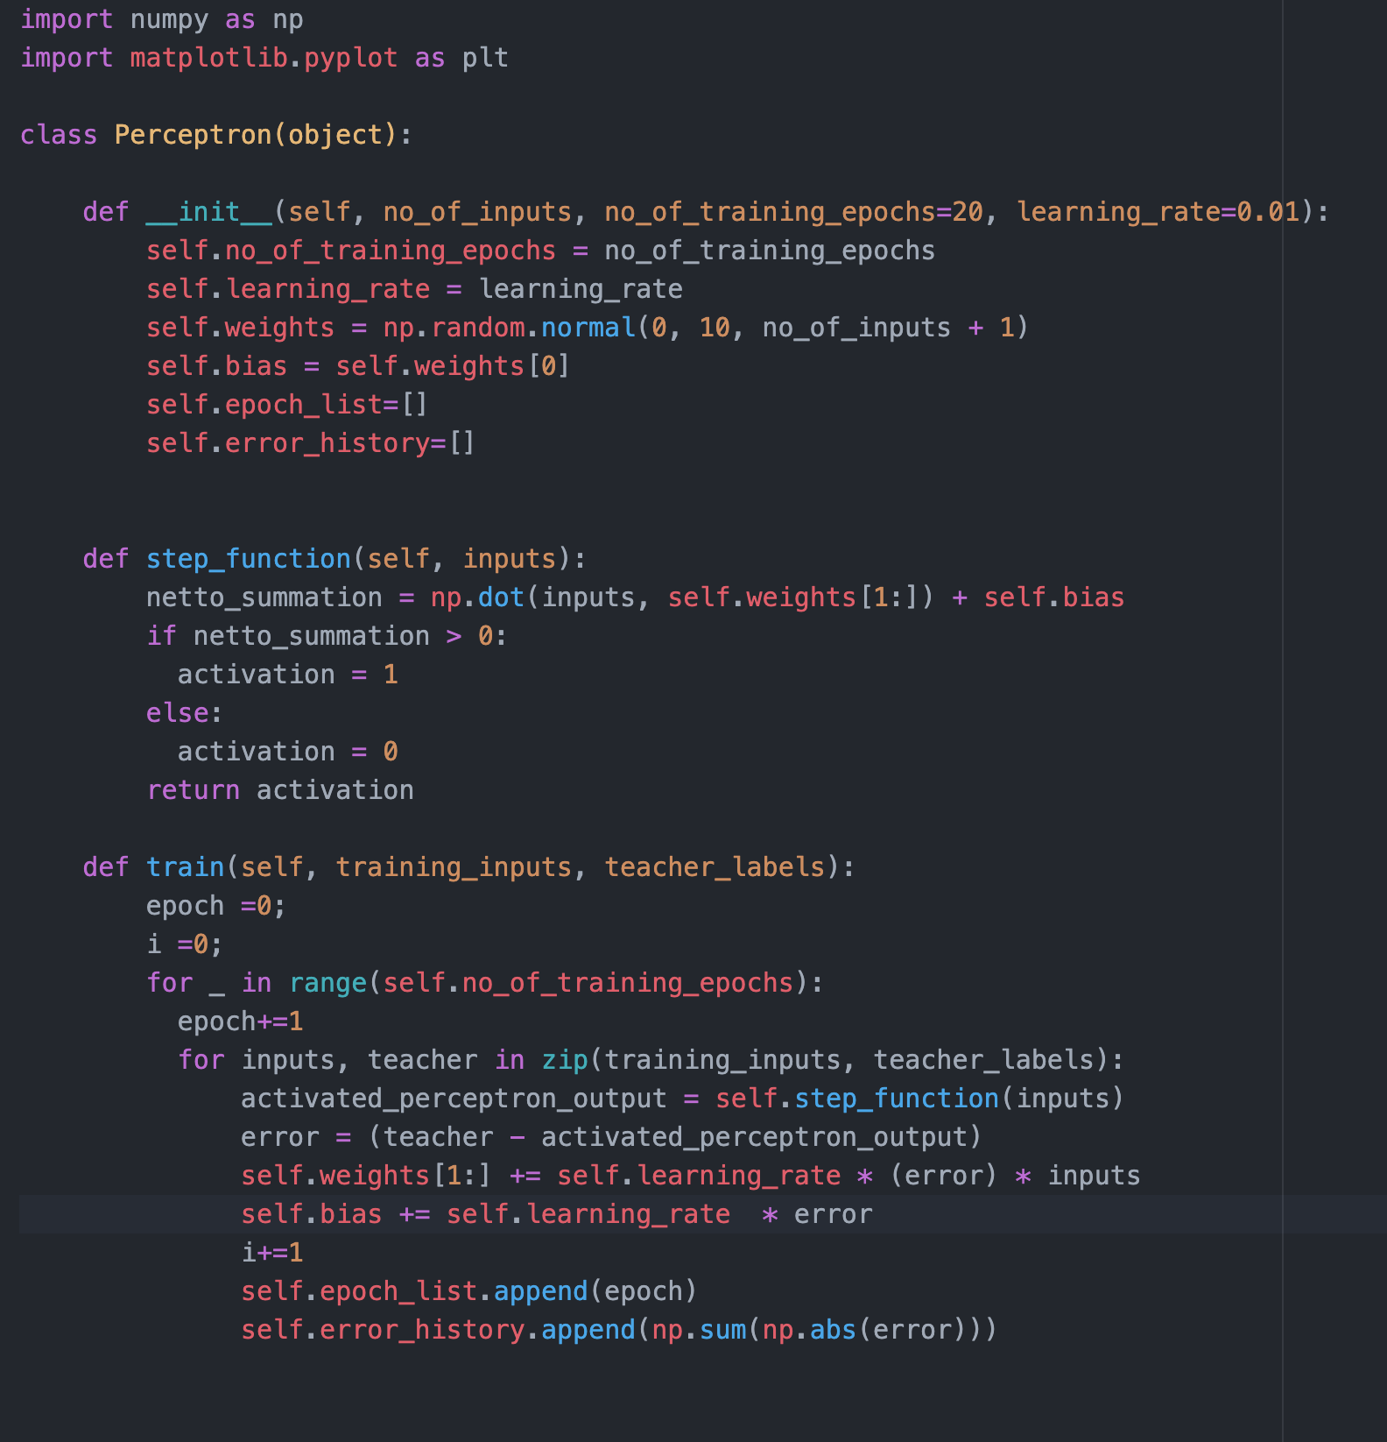
XOR Puzzle!
PYTHON PERCEPTRON MODEL code
import Numpy as np
import Matlibplot.pyplot as plt
Where are input & ouput specified?
Where are the weights initialized?
How is the Forward computation specified?
To Do:
Change the code as to print
Interation number
Bach number
Error
And weights

Slide 35

Simple Predicting Machine

Slide 36
XOR Puzzle!
PYTHON
INPUT / OUTPUT relationship code
import Numpy as np
import Matlibplot.pyplot as plt
import numpy as np
inputs = []
inputs.append(np.array([1, 1]))
inputs.append(np.array([1, 0]))
inputs.append(np.array([0, 1]))
inputs.append(np.array([0, 0]))
teacher = np.array([1, 0, 0, 0])
USING ZIP
print([inputs for teacher in zip(inputs, teacher)])
print([i for i in zip(inputs, teacher)])

Slide 37
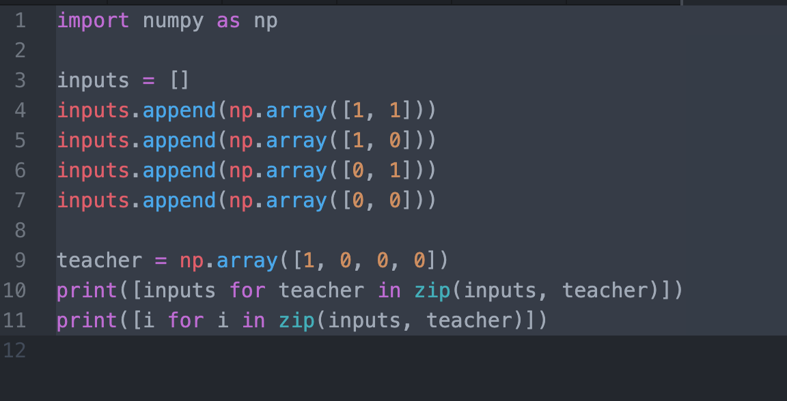
{01}
ANSWERS
ZIP function
Coded Python Perceptron class object
[[array([1, 1]), array([1, 0]), array([0, 1]), array([0, 0])], [array([1, 1]), array([1, 0]), array([0, 1]), array([0, 0])], [array([1, 1]), array([1, 0]), array([0, 1]), array([0, 0])], [array([1, 1]), array([1, 0]), array([0, 1]), array([0, 0])]]

Slide 38
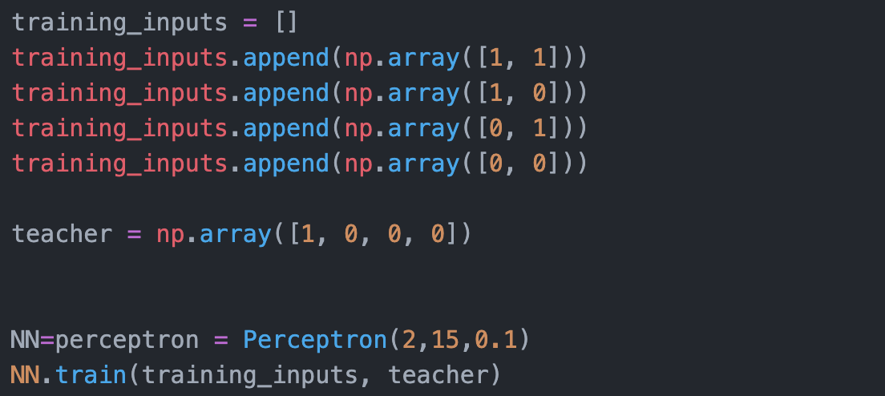
{01}
ANSWERS
Training of the
Coded Python Perceptron class object

Slide 39
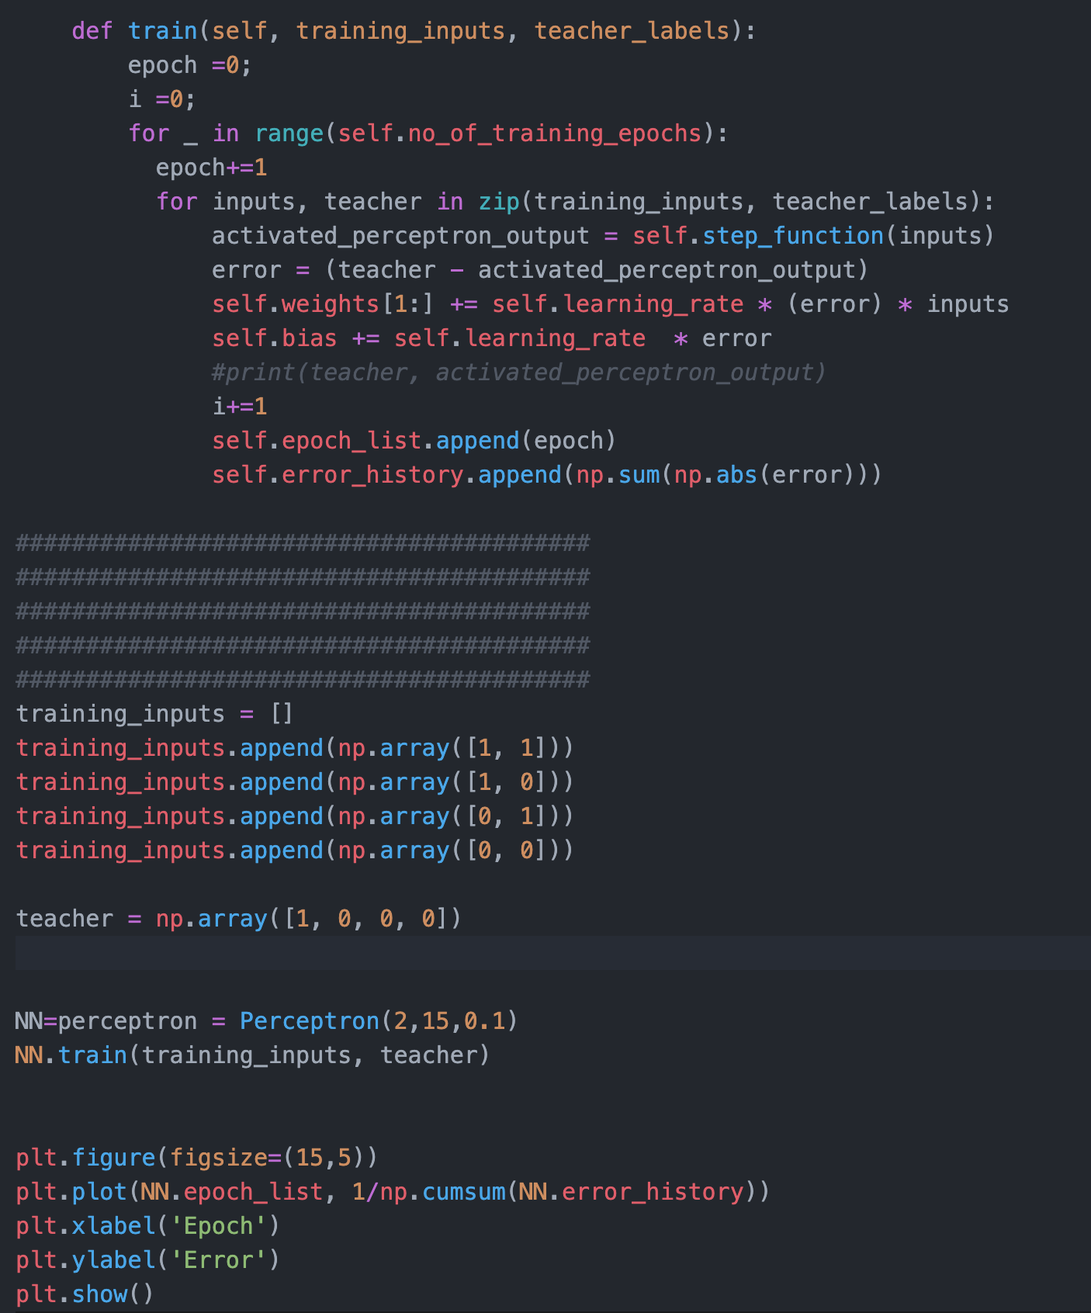
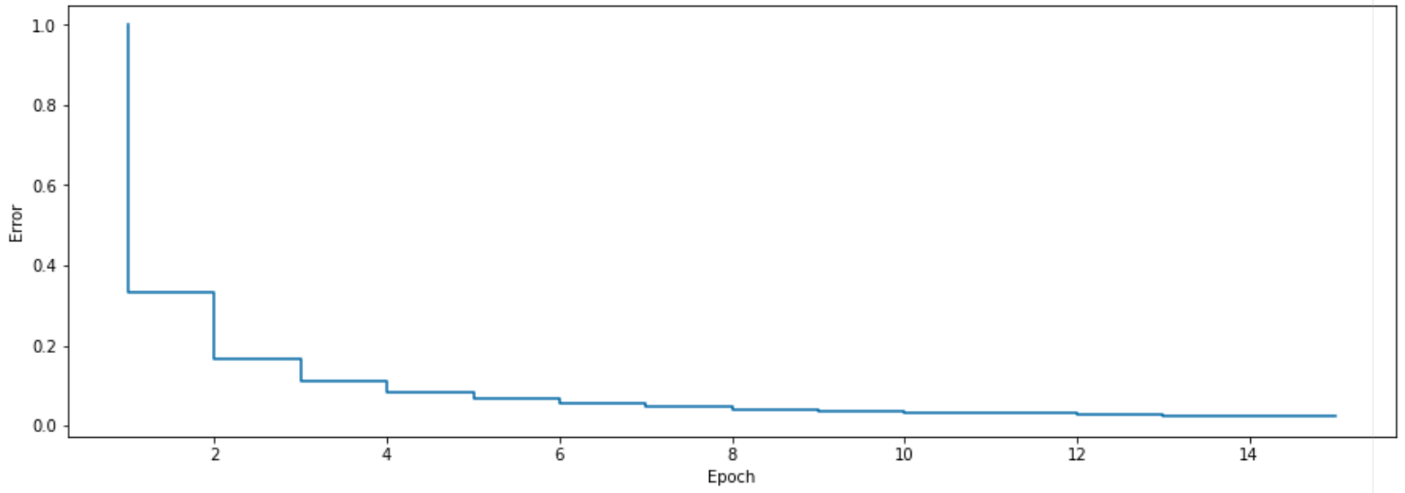
{01}
ANSWERS
Evidence of learning through training of the
Coded Python Perceptron class object

Slide 40
{01}
Fundamentals
Network Error
How do you determine if
a Perceptron has learned
the input/output relationship?
Target label [TEACHER]
Input x1 | Input x2 | AND y
0 | 0 | 0
0 | 1 | 0
1 | 0 | 0
1 | 1 | 1

Slide 41
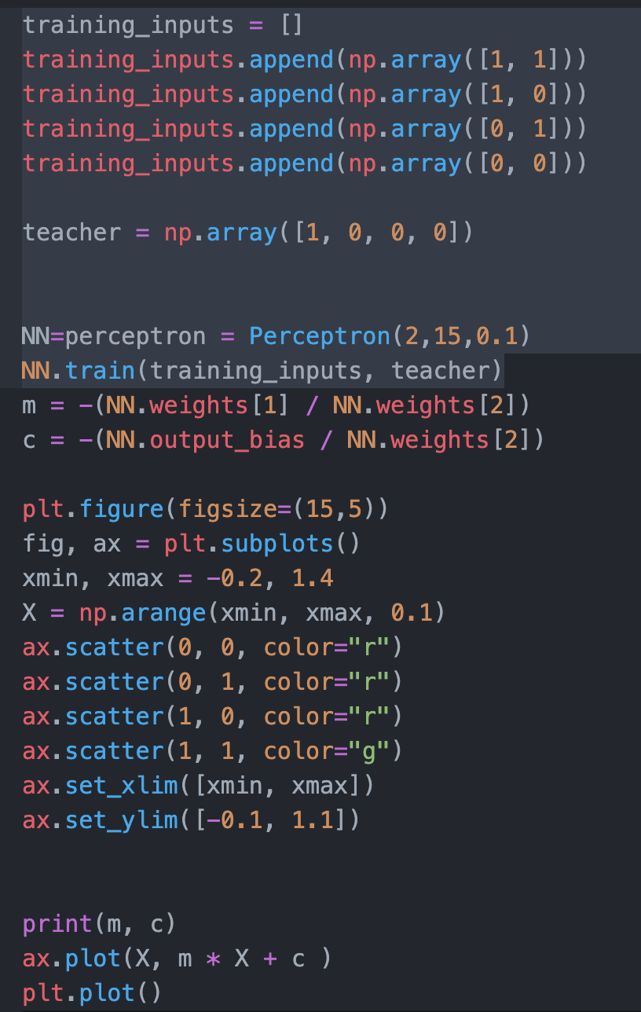
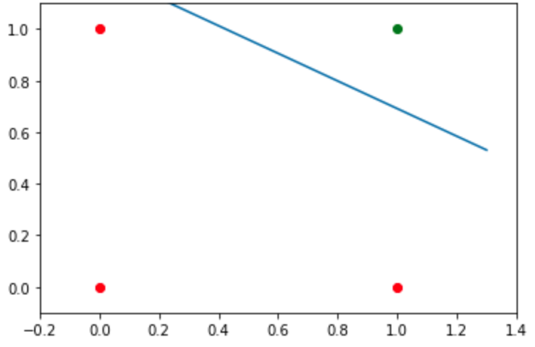
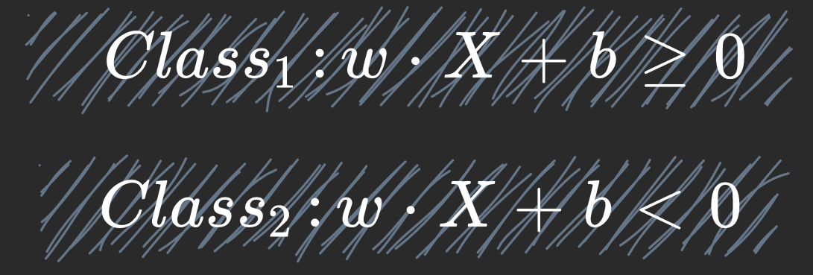
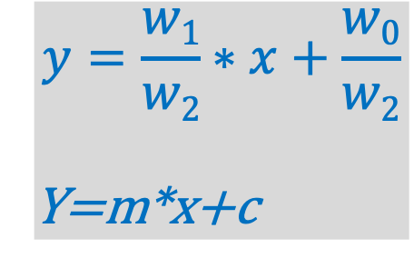
{01}
ANSWERS
Evidence of learning through training of the
Coded Python Perceptron class object
Input (x) | Output (y) Space
$$y=\frac{w1}{w2}∗x+\frac{w0}{w2}$$
Y=m*x+c

Slide 42
XOR Puzzle!
Input (x) | Output (y) Space

Slide 43
XOR Puzzle!
PYTHON PERCEPTRON MODEL code
import Numpy as np
import Matlibplot.pyplot as plt
Where are input & ouput specified?
Where are the weights initialized?
How is the Forward computation specified?
To Do:
Change the code as to print
Interation number
Bach number
Error
And weights

Slide 44
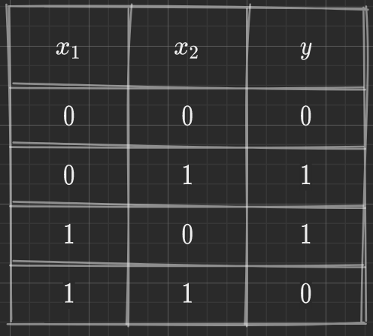
Code Python Perceptron class object
for XOR PROBLEM
XOR Puzzle!

Slide 45
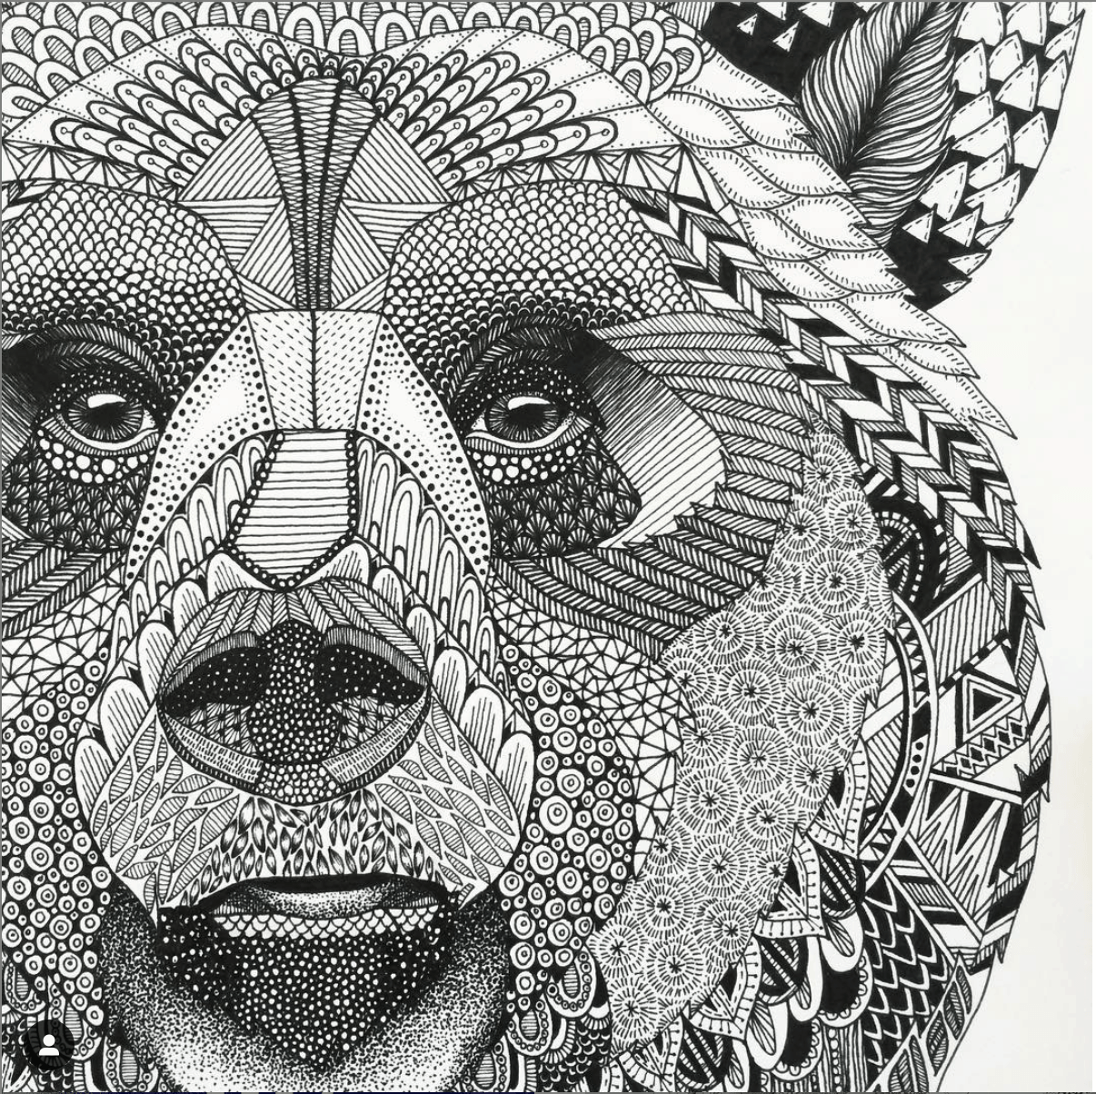
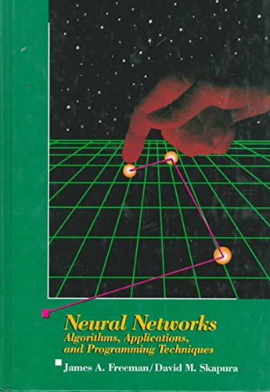
{04}
Do it Yourself
Write code in Pyton
that solves the XOR problem based
on the perceptron neural network architecture using the BACKPROPAGATION learning rule algorithm.
Use the description of Backpropagation as specified in:

Slide 46
{04}
Do it Yourself
Use import Numpy as np
import Matlibplot.pyplot as plt
Where are input & ouput specified?
Where are the weights + biases initialized?
What type of Activation function must be used.
How is the Forward computation specified?
How is Backward adaptation specified (BACKPROPAGATION)
Demonstate that your network learns and has solved the XOR input-output relationship.

Slide 47
XOR Puzzle!

Slide 48
XOR Puzzle!

Slide 49
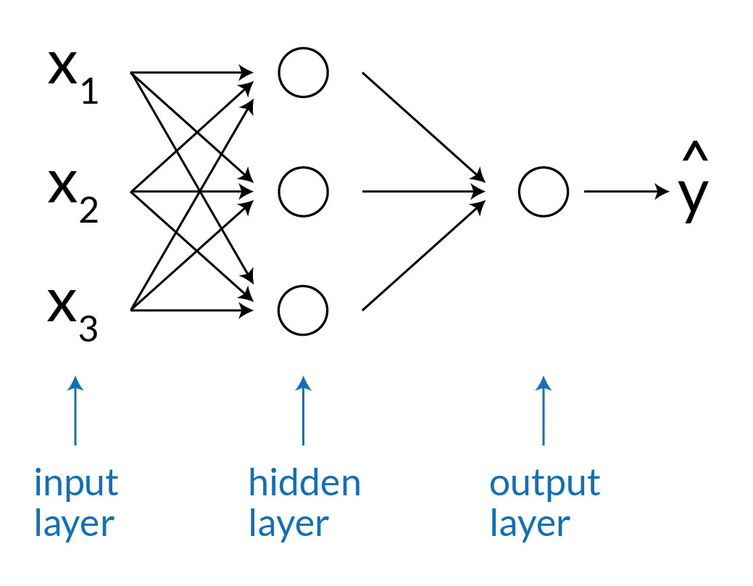
Simple Predicting Machine
Code Python Perceptron class object
for XOR PROBLEM requires hidden layer

Slide 50
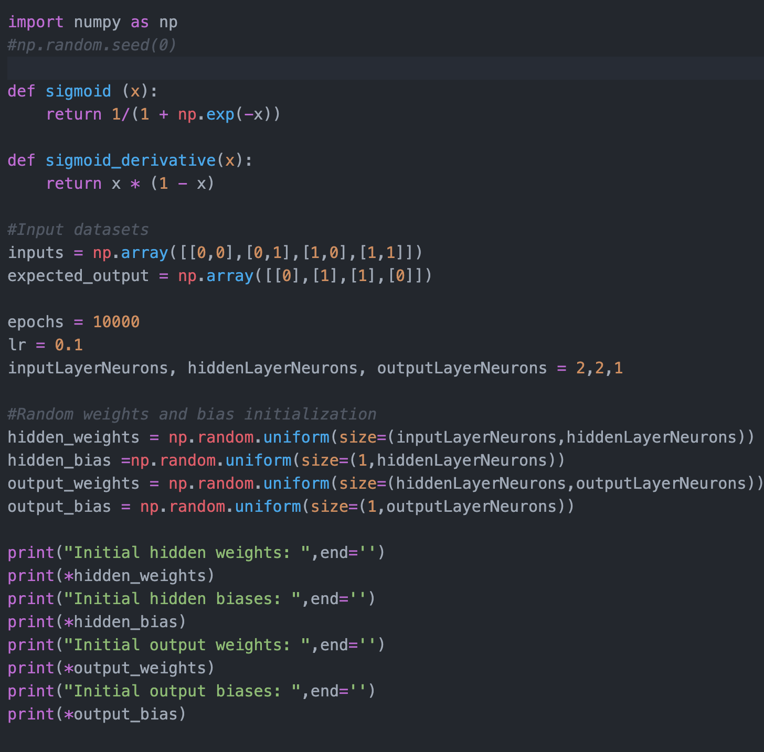
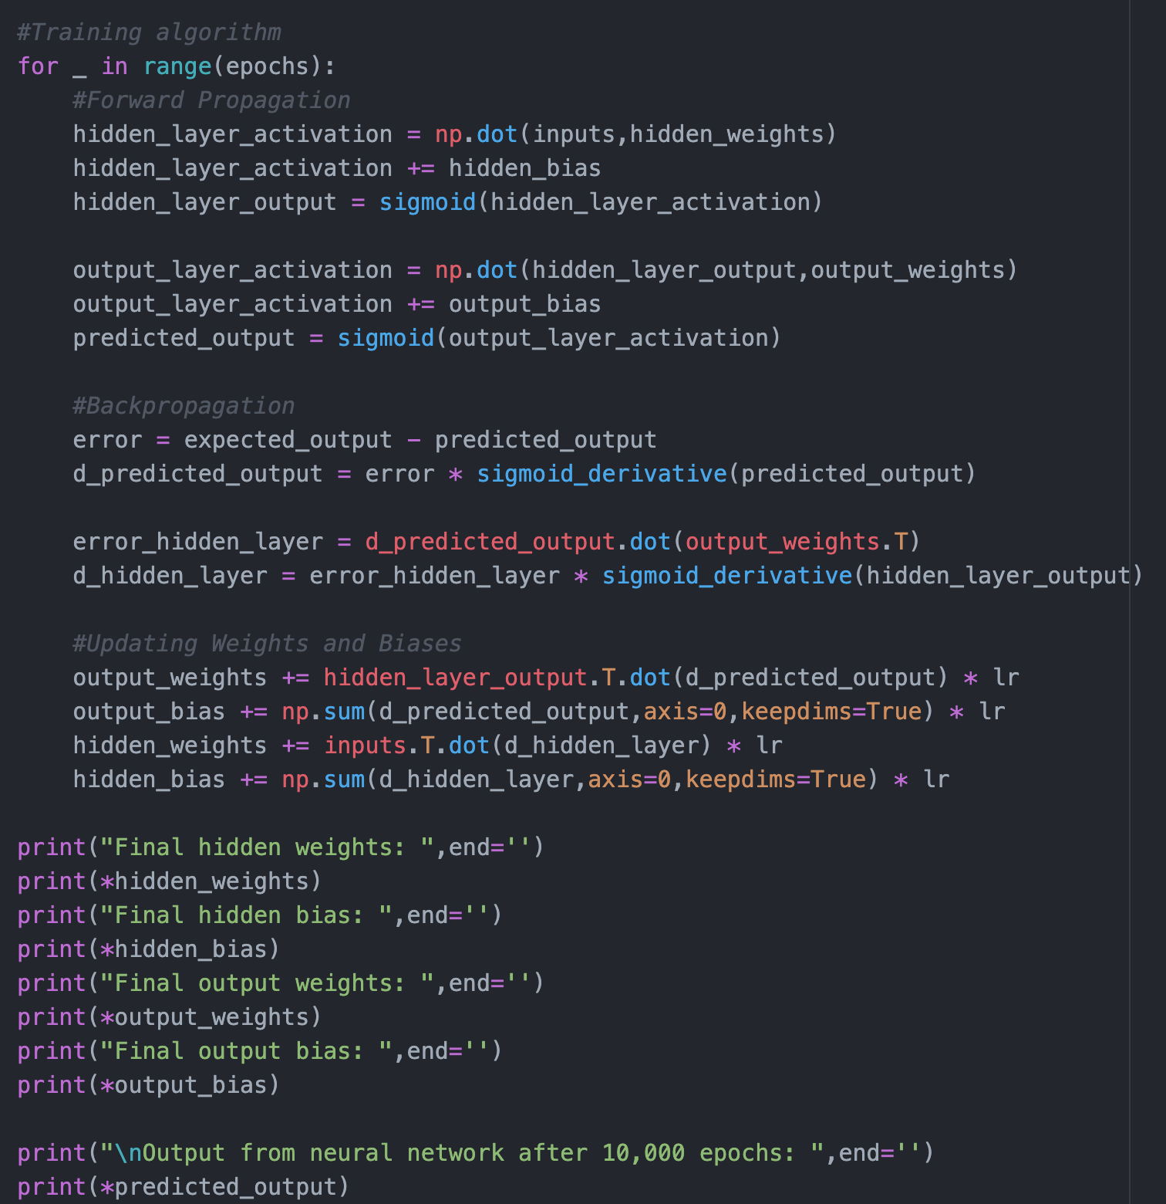
{01}
Fundamentals
Example Python Code
Perceptron class object for XOR PROBLEM

Slide 51


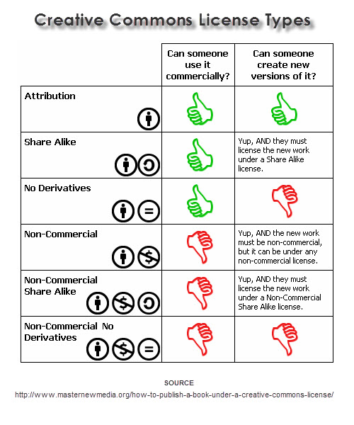
This lesson was developed by:
Robert Frans van der Willigen
CMD, Hogeschool Rotterdam
OKT 2020
http://creativecommons.org/licenses/by-nc-sa/3.0/
This lesson is licensed under a Creative Commons Attribution-Share-Alike license. You can change it, transmit it, show it to other people. Just always give credit to RFvdW.
http://empoweringthenatives.edublogs.org/2012/03/15/creative-commons-licenses/
http://creativecommons.org/licenses/

Slide 53
